Slide 1

DMDD FINAL PROJECT
TOPIC- EVENT MANAGEMENT SYSTEM
GROUP NUMBER-19
TEAM MEMBERS-
DAVLEEN KAUR RAM SINGH MATTA-002734160
ATHARVA DANKE-002762773
ANSHUL SINGH-002747160
ADITYA PANDE-002762581

Slide 2
HIGH LEVEL DESIGN & APPROACH
Designing an event management system that will help students keep track of all the events that are organized by various clubs or committees at Northeastern University.
Create a centralized system that will maintain the data of events organized by clubs or committees so that students may get to know about the events that will be occurring on the university campus.
This system will also enable students to register for any event they are interested in participating in.
Ensure that the results of the competition-based events can be accessed from the database.
OBJECTIVES & GOALS
In this project, our aim is to design an event management system that will help students to keep a track of all the events that are organized by various clubs or committees at Northeastern University.
This system will enable students to register for any event they are interested in participating.
Additionally, keeping a systematic record of many factors, such as the number of students, the number of events scheduled, the timeline of the events, etc., can assist the university in planning future events utilizing this information.

Slide 3
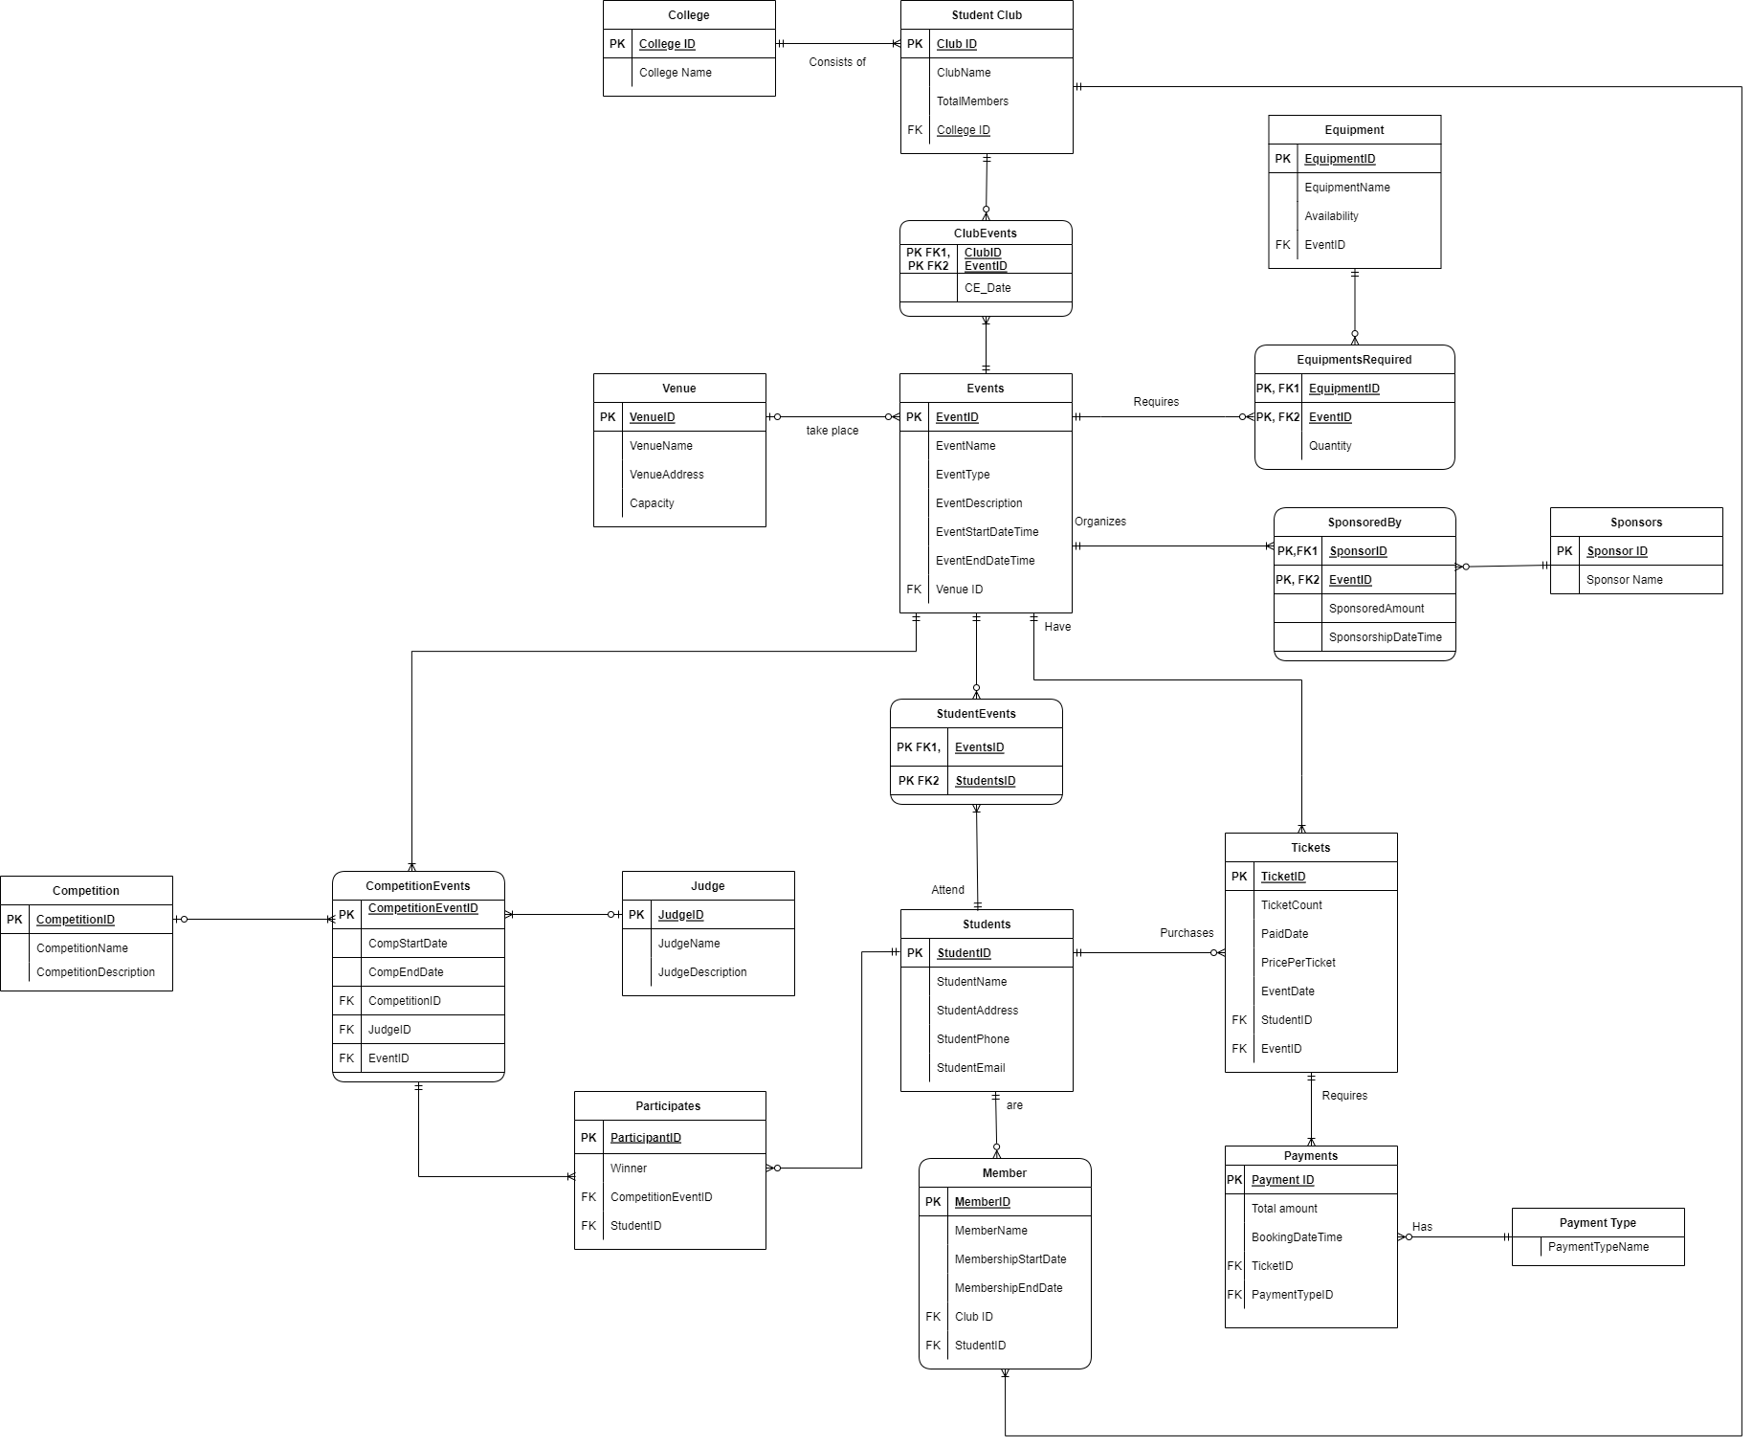
E-R Diagram

Slide 4
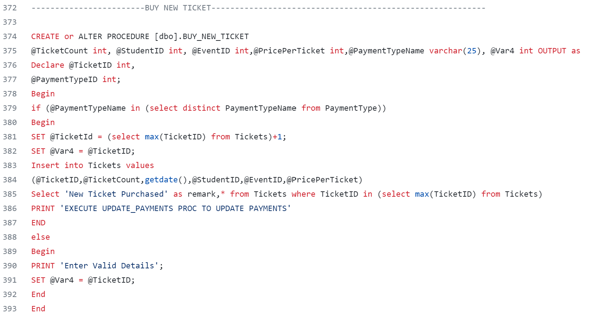
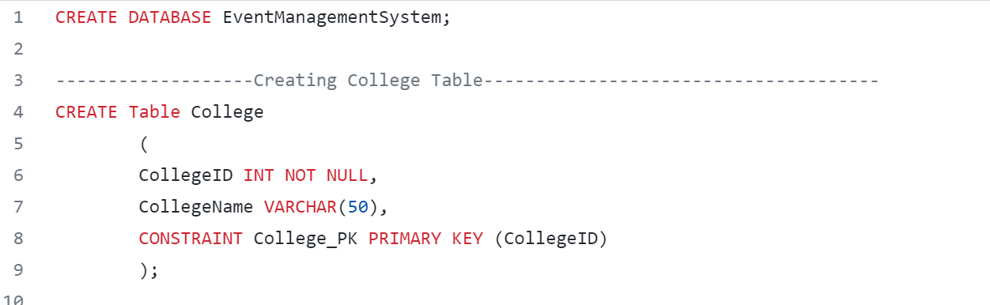
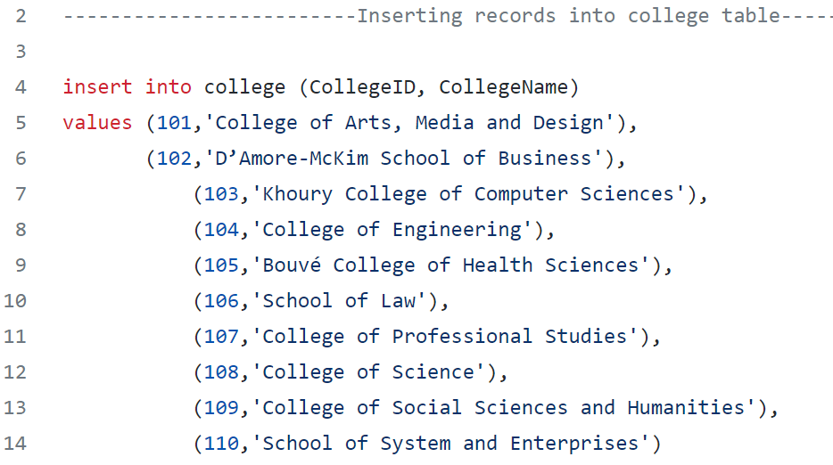
DATABASE OBJECTS
DDLS & INSERT
STORED PROCEDURES

Slide 5
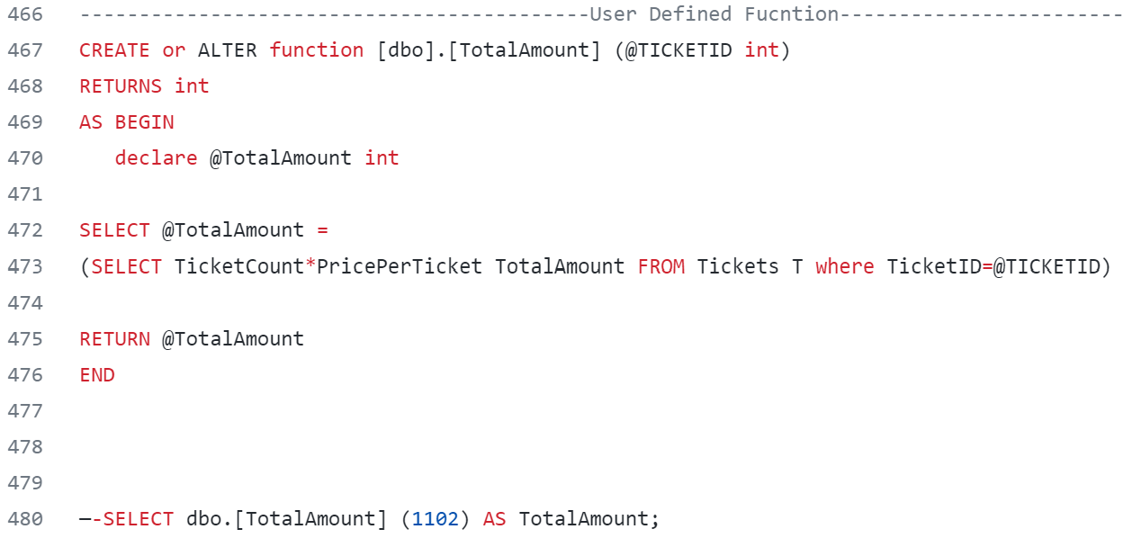
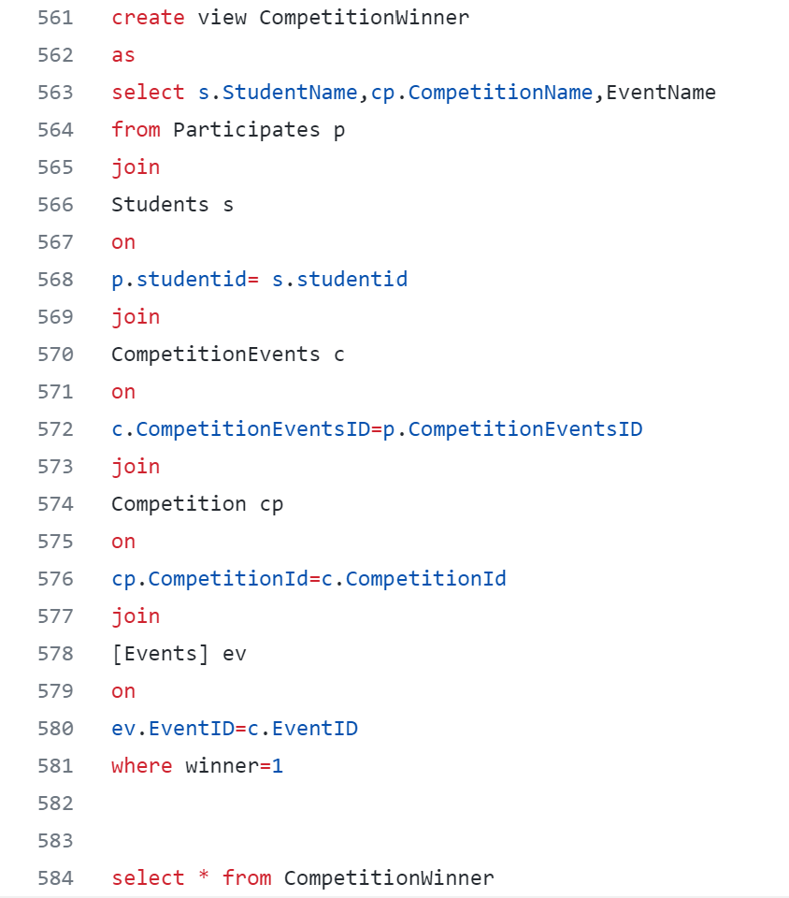
USER DEFINED FUNCTIONS
VIEWS

Slide 6
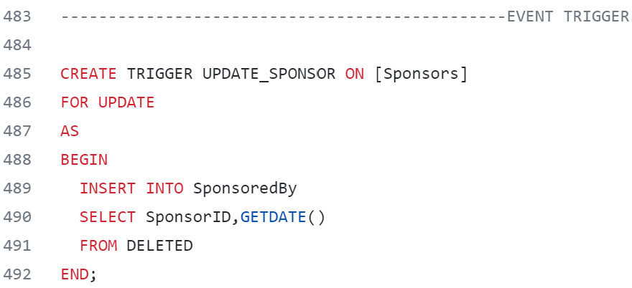
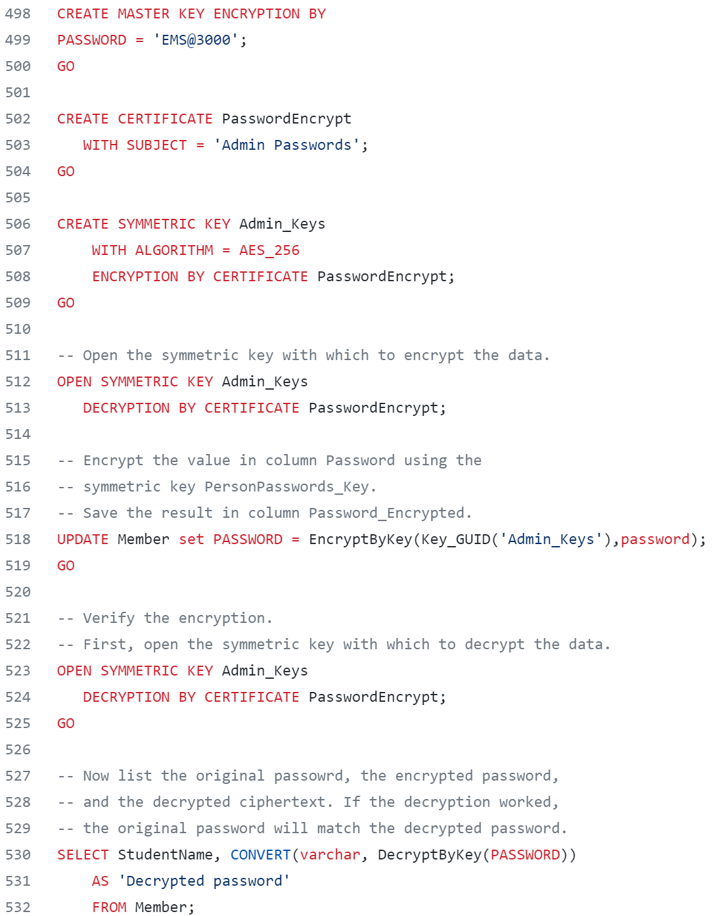
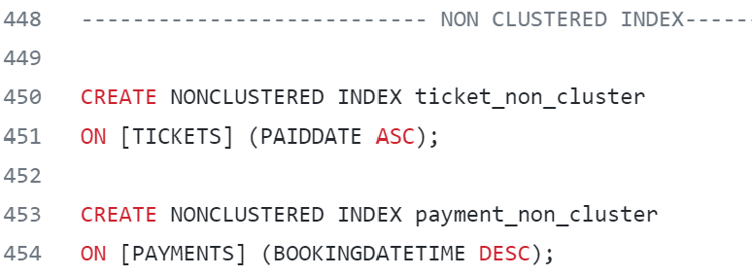
TRIGGERS & INDEXES
DATA ENCRYPTION

Slide 7
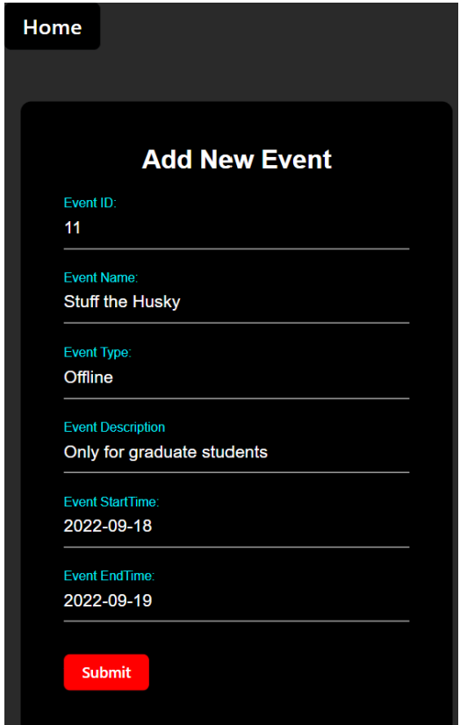
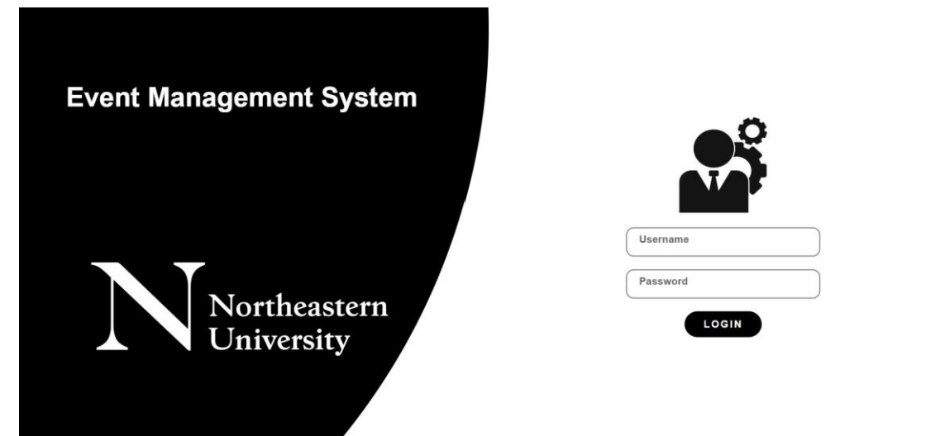
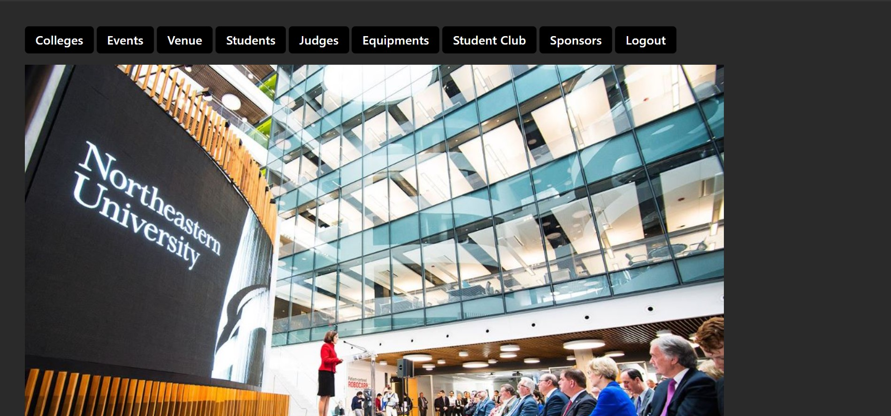
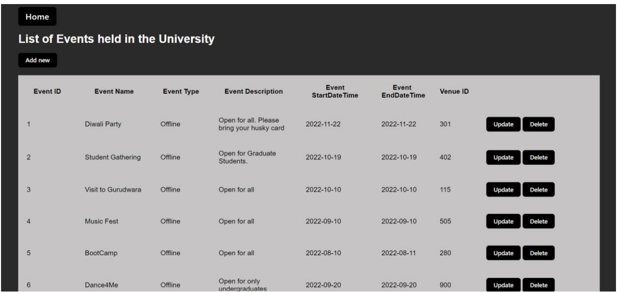
PRESENTATION LAYER
GUI

Slide 8
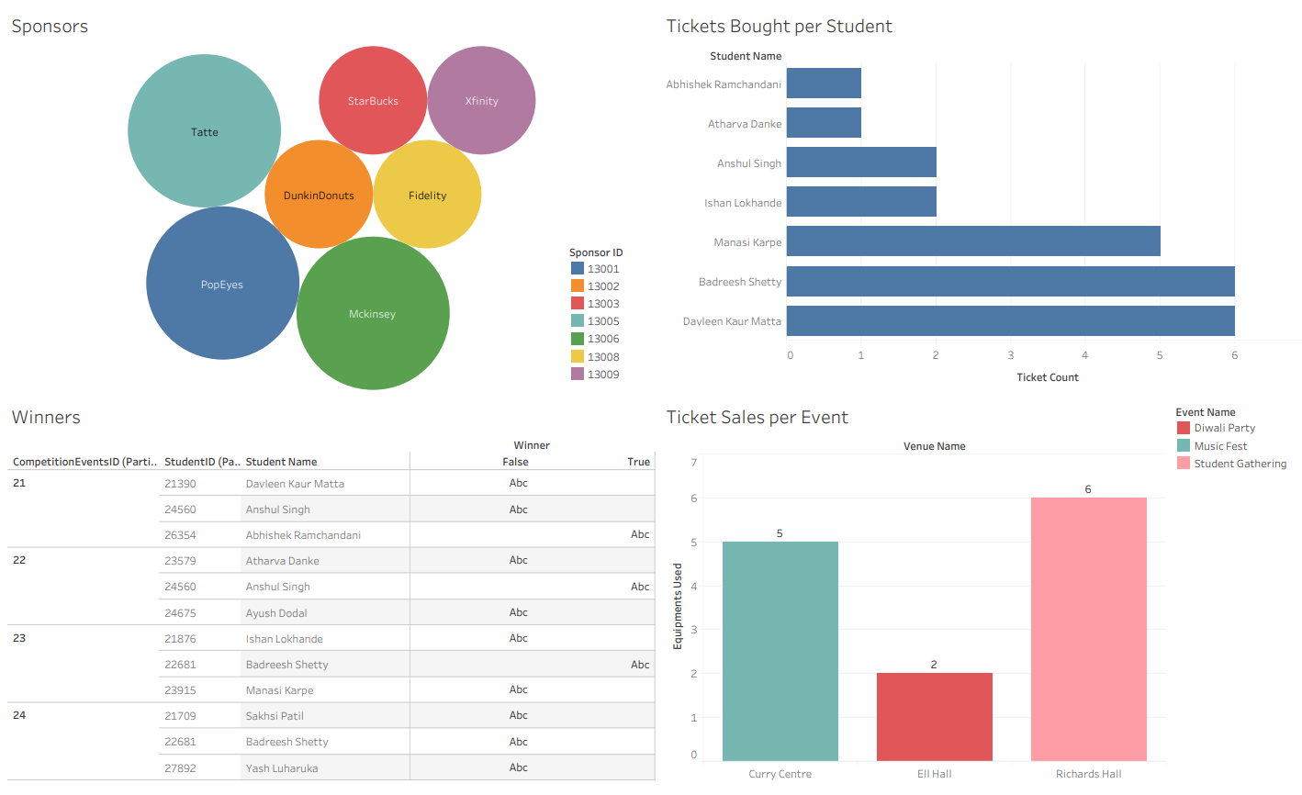
DATA VISUALISATION

